Slide 1

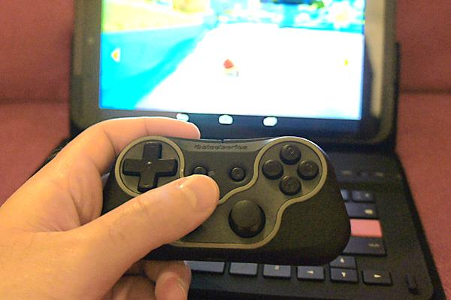
4. User Input
Let’s Learn
Aj. Andrew Davison, CoE, PSU Hat Yai Campus
E-mail: ad@fivedots.coe.psu.ac.th

Slide 2
Outline
Types of User Input
Keyboard Events
Mouse Events
Mouse Demo
Gamepad (Joystick)
Moving a Stick Man

Slide 3
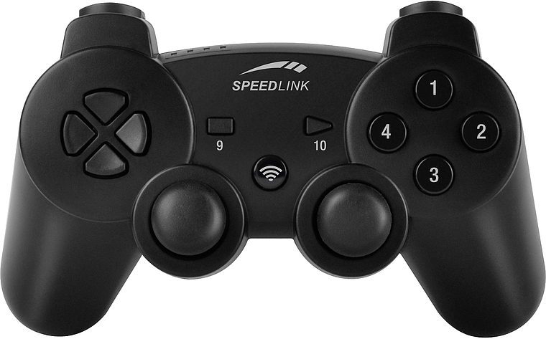
1. Types of User Input
Pygame can process events from:
the keyboard
http://www.pygame.org/docs/ref/key.html
the mouse
http://www.pygame.org/docs/ref/mouse.html
gamepads (pygame calls them joysticks)
http://www.pygame.org/docs/ref/joystick.html
Pygame must initialize the gamepads first

Slide 4
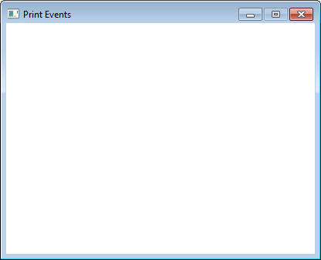
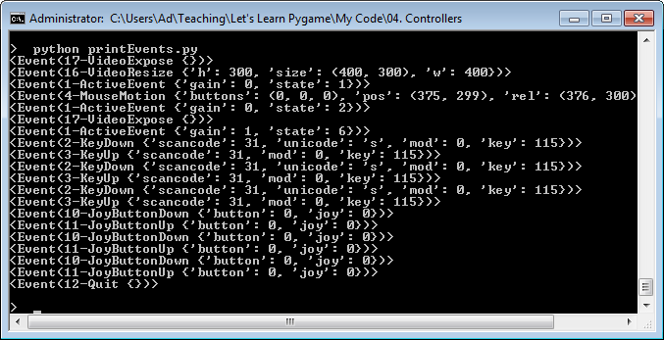
Printing all Events (printEvents.py)

Slide 5
Code
import pygame
from pygame.locals import *
pygame.init()
screen = pygame.display.set_mode((400, 300))
screen.fill((255,255,255)) # white background
pygame.display.set_caption("Print Events")
clock = pygame.time.Clock()
# initialize joysticks
for i in range(pygame.joystick.get_count()):
j = pygame.joystick.Joystick(i)
j.init()
running = True
while running:
clock.tick(30)
for event in pygame.event.get():
if event.type == QUIT:
running = False
print(event)
pygame.display.update()
pygame.quit()

Slide 6
2. Keyboard Events
The unicode value is a character (e.g. 'd'), while key is a Pygame key code (e.g. K_d).
mod is a modifier key, which is 0 if no modifier key is being pressed
modifiers include <ctrl>, <shift>, <alt>

Slide 7
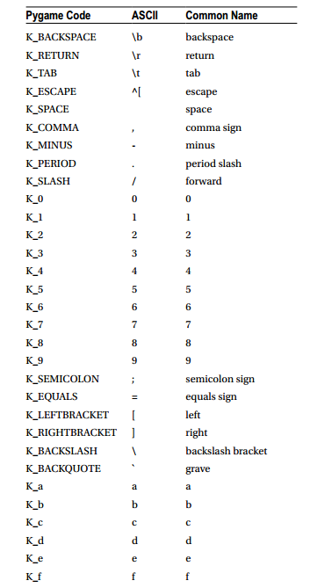
Some Pygame Key Codes
See http://www.pygame.org/ docs/ref/key.html for full details.

Slide 8
Example
while running:
clock.tick(30)
for event in pygame.event.get():
if event.type == QUIT:
running = False
if event.type == KEYDOWN:
if event.key == K_ESCAPE:
running = False
This sets running to False if the escape key is pressed down.
could also look at
event.mod and event.unicode

Slide 9
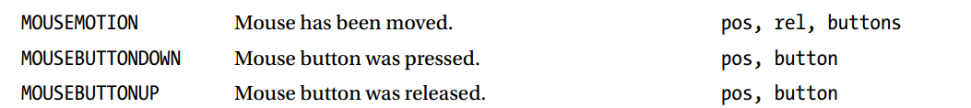
3. Mouse Events
pos is the mouse's (x,y) position inside the Pygame window
rel is a relative move (xChange, yChange), which will be negative if up or to the left
buttons is a tuple of 3 button states
button is the ID of the button that sent the event
IDs start at 1; the middle button is ID 2, 4, and 5!

Slide 10
Using Mouse Functions
The 3 most useful mouse functions are:
pygame.mouse.get_pressed()
returns the mouse buttons pressed as a tuple of three booleans, one for the left, middle, and right mouse buttons
e.g. [ True, False, False ]
pygame.mouse.get_pos()
returns the mouse coordinates inside the window as a tuple of x and y values
e.g. [ 240, 320 ]
pygame.mouse.get_rel()
returns the relative mouse movement as a tuple of x and y value
e.g. [-10, 24]

Slide 11
Example
while running:
clock.tick(30)
for event in pygame.event.get():
if event.type == QUIT:
running = False
if event.type == MOUSEBUTTONDOWN and \
pygame.mouse.get_pressed()[1]: # middle button
running = False
pos = pygame.mouse.get_pos()
x, y = pos[0], pos[1]
running stops when the
middle mouse button
is pressed

Slide 12
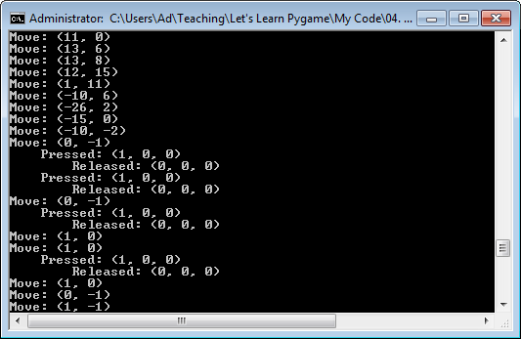
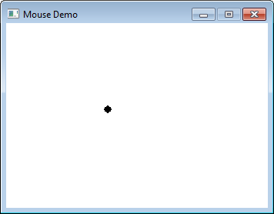
4. Mouse Demo (mouseDemo.py)
Moves a black dot around the window
Prints relative position, pressed/released info.

Slide 13
Code
import pygame
from pygame.locals import *
BLACK = ( 0, 0, 0)
WHITE = ( 255, 255, 255)
pygame.init()
screen = pygame.display.set_mode([340,240])
pygame.display.set_caption("Mouse Demo")
clock = pygame.time.Clock()
# Hide the mouse cursor
pygame.mouse.set_visible(0)
running = True
while running:
clock.tick(30)
for event in pygame.event.get():
if event.type == QUIT:
running = False
:

Slide 14
if event.type == MOUSEBUTTONDOWN:
print(' Pressed:',
pygame.mouse.get_pressed())
elif event.type == MOUSEBUTTONUP:
print(' Released:',
pygame.mouse.get_pressed())
if event.type == MOUSEMOTION:
print('Move:', pygame.mouse.get_rel())
# redraw
screen.fill(WHITE)
# draw a circle around the mouse pointer
pos = ( pygame.mouse.get_pos()[0],
pygame.mouse.get_pos()[1])
pygame.draw.circle(screen, BLACK, pos, 5, 0)
pygame.display.update()
pygame.quit()

Slide 15
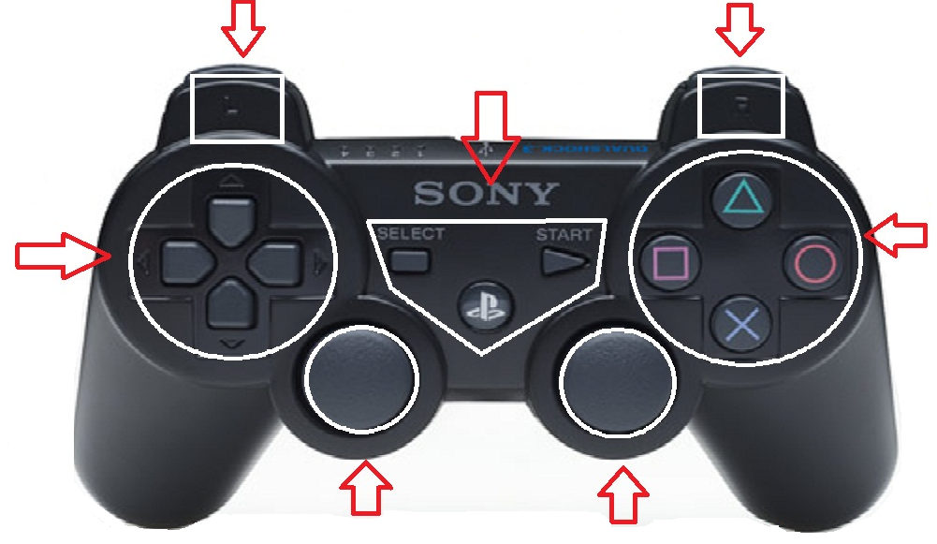
5. Gamepad (Joystick)
a typical gamepad has 4 kinds of input
buttons
buttons
buttons
D Pad
(hat)
left, right,
up, down
buttons
axes (analog sticks)
each stick has 2 axes
+ track balls

Slide 16
Joystick(s) Initialization
Pygame will not receive joystick events unless the joysticks are initialized before the game loop:
for i in range(pygame.joystick.get_count()):
j = pygame.joystick.Joystick(i) # initialize all joysticks
j.init()
running = True
while running:
: # get events from any/all of the joysticks

Slide 17
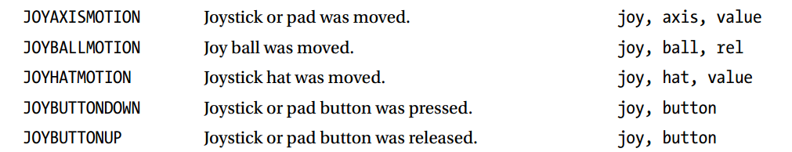
Joystick Events
joy is the ID numbers for the joystick that sent the event
ID start at 0
axis, ball, hat, and button are ID numbers
ID for each kind start at 0

Slide 18
Example
while running:
clock.tick(30)
for event in pygame.event.get():
if event.type == QUIT:
running = False
if event.type == JOYBUTTONDOWN and \
event.button == 2: # usually the 'X' button
running = False # as shown on slide 15
running stops when the
button 2 of the joystick
is pressed

Slide 19
Joystick Functions
When using D-Pads (hats), trackballs, or analog sticks (axes), it is easier to use joystick functions.
see http://www.pygame.org/docs/ref/joystick.html
There are 2 types of "get" function:
pygame.joystick.Joystick.get_numXXX()
gets the number of XXX's
pygame.joystick.Joystick.get_XXX(id)
gets info on XXX which has id number

Slide 20
Examples
for i in range(joystick.get_numbuttons()):
if joystick.get_button(i):
print("pressed", i)
else:
print("not pressed", i)
for i in range(joystick.get_numhats()):
xAxis, yAxis = joystick.get_hat(i)
// values are 1,0,-1

Slide 21
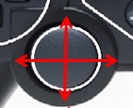
for i in range(joystick.get_numballs()):
xRel, yRel = joystick.get_ball(i)
// values are positive/negative integers
for i in range(joystick.get_numaxes()):
print( joystick.get_axis(i) )
// value is float between -1 and 1
The axis data is the hardest to use since one "stick" uses two axes: one for the x-axis, one for the y-axis
one stick; two axes

Slide 22
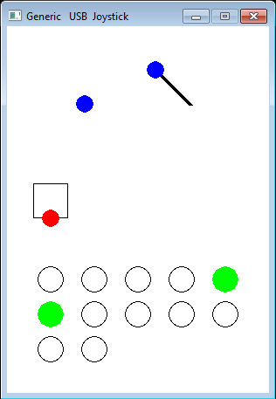
joyDemo.py GUI
2 analog sticks
( 4 axes)
right stick is being
pushed left and up
using 2 axes
D Pad (1 hat)
left (-1), right (1),
up (1), down (-1)
12 buttons
(green =
pressed)

Slide 23
6. Moving a Stick Man
move_keyboard.py, move_mouse.py, and move_joy.py all 'do' the same thing:
they move a little "stick man" around the Pygame window
but they use different input techniques:
arrow keys in move_keyboard.py
mouse movement in move_mouse.py
the left stick in move_joy.py
Keep redrawing the stick man inside the Pygame game loop at a new (x,y).

Slide 24
6.1 Drawing a Stick Man
(x, y)
(x+5,
y+17)
All 3 programs contain the same draw_stick_figure() function:
def draw_stick_figure(screen, x, y):
# Head
pygame.draw.ellipse(screen, BLACK, [1 + x, y, 10, 10], 0)
# Legs
pygame.draw.line(screen, BLACK, [5 + x, 17 + y], [10 + x, 27 + y], 2)
pygame.draw.line(screen, BLACK, [5 + x, 17 + y], [x, 27 + y], 2)
# Body
pygame.draw.line(screen, RED, [5 + x, 17 + y], [5 + x, 7 + y], 2)
# Arms
pygame.draw.line(screen, RED, [5 + x, 7 + y], [9 + x, 17 + y], 2)
pygame.draw.line(screen, RED, [5 + x, 7 + y], [1 + x, 17 + y], 2)
(x+10,
y+27)

Slide 25
6.2. move_keyboard.py
pygame.init()
screen = pygame.display.set_mode([700, 500])
pygame.display.set_caption("Move Keyboard")
clock = pygame.time.Clock()
# move step in pixels done by a key
xStep = 0; yStep = 0
# Current position of stick man
x = 10; y = 10
running = True
while running:
clock.tick(30)
for event in pygame.event.get():
if event.type == QUIT:
running = False
:

Slide 26
if event.type == KEYDOWN:
if event.key == K_ESCAPE:
running = False
# if an arrow key, adjust step
elif event.key == K_LEFT:
xStep =- 3
elif event.key == K_RIGHT:
xStep = 3
elif event.key == K_UP:
yStep =- 3
elif event.key == K_DOWN:
yStep = 3
elif event.type == KEYUP:
# if an arrow key, reset step to zero
if event.key == K_LEFT:
xStep = 0
elif event.key == K_RIGHT:
xStep = 0
elif event.key == K_UP:
yStep = 0
elif event.key == K_DOWN:
yStep = 0
# Move according to the step values
x += xStep
y += yStep
screen.fill(WHITE)
draw_stick_figure(screen, x, y)
pygame.display.update()
pygame.quit()

Slide 27
6.3. Disappearing Stick Man
The (x,y) position of the stick man can be changed to anything, including values that are off the edges of the window!
e.g. (-100, 20), (1000, 56), (14, -50), (100, 700)

Slide 28
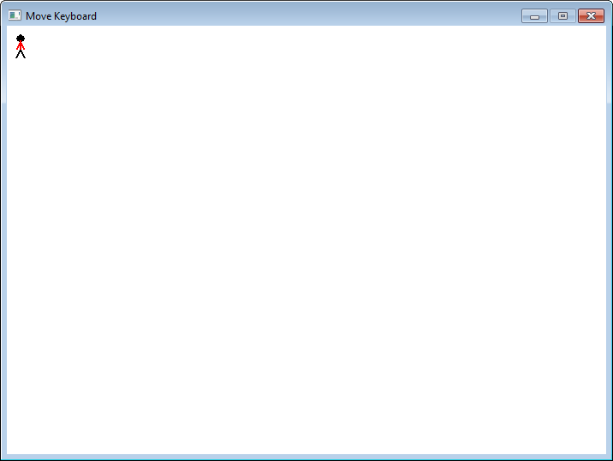
Limiting the Stick man's Position
I do not want the stick man to disappear off the sides of the window.
There are 4 sides with x and y values:
(0,0)
x-axis
(700,0)
y-axis
(0,500)
(700,500)

Slide 29

Min and Max x's and y's
Left side: minimum x == 0
Top side: minimum y == 0
Right side: maximum x = 700-1
but want all of stick man to be seen, so max x = 700 – 1 – 10
Bottom side: maximum y = 500-1
but want all of stick man to be seen, so max y = 500 – 1 – 27
right, bottom
of window

Slide 30
This position limiting of (x, y) is implemented in all 3 programs by the same function, limitPos():
def limitPos(screen, x, y):
width, height = screen.get_size()
if (x < 0):
x = 0
elif (x > width-1 - 10): # add in stick figure max width
x = width-1 - 10
if (y < 0):
y = 0
elif (y > height-1 - 27): #add in stick figure max height
y = height-1 - 27
return (x, y)

Slide 31
Changes to main
Inside the game loop, replace:
x += xStep
y += yStep
by:
x, y = limitPos(screen, x+xStep, y+yStep)

Slide 32
6.4. move_mouse.py
pygame.init()
screen = pygame.display.set_mode([700, 500])
pygame.display.set_caption("Move Mouse")
clock = pygame.time.Clock()
# Hide the mouse cursor
pygame.mouse.set_visible(0)
running = True
while running:
clock.tick(30)
for event in pygame.event.get():
if event.type == QUIT:
running = False
:
Simpler code since no need for x, y, xStep, and yStep

Slide 33
if event.type == MOUSEBUTTONDOWN and \
pygame.mouse.get_pressed()[1]: # middle button pressed
running = False
pos = pygame.mouse.get_pos() # pos is [x, y] of mouse
x, y = limitPos(screen, pos[0], pos[1])
# redraw
screen.fill(WHITE)
draw_stick_figure(screen, x, y)
pygame.display.update()
pygame.quit()

Slide 34
6.5. move_joy.py
pygame.init()
screen = pygame.display.set_mode([700, 500])
pygame.display.set_caption("Move Joy")
clock = pygame.time.Clock()
# Current position of stick man
x = 10; y = 10
joys = initJoys()
joy = joys[0]
running = True
while running:
clock.tick(30)
for event in pygame.event.get():
if event.type == QUIT:
running = False
:
Must initialize joysticks in Pygame and set stick man's start position.

Slide 35
Pressing any joystick button will stop the program running.
if event.type == JOYBUTTONDOWN:
running = False
# move using left analog stick (uses axes 0 and 1)
# multiply by 10 to increase step to -10 -- 10 range
x += int(joy.get_axis(0) * 10)
y += int(joy.get_axis(1) * 10)
x, y = limitPos(screen, x, y)
# redraw
screen.fill(WHITE)
draw_stick_figure(screen, x, y)
pygame.display.update()
pygame.quit()
This approach "feels" the best. The stick man can move in more directions because the axes can range over more values.

Slide 36
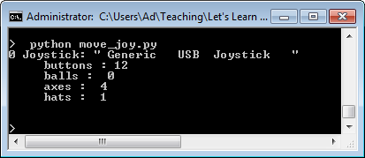
Initializing the Joysticks
def initJoys():
# create a list of joysticks
joys = []
for i in range(pygame.joystick.get_count()):
j = pygame.joystick.Joystick(i)
j.init()
joys.append(j)
# report joystick charateristics
print(i, "Joystick: \"", j.get_name(), "\"")
print(" buttons :", j.get_numbuttons())
print(" balls : ", j.get_numballs())
print(" axes : ", j.get_numaxes())
print(" hats : ", j.get_numhats())
print("")
if not joys:
print("No joysticks found")
pygame.quit()
sys.exit()
return joys

